Slide 1
Waves and Sound
Physical Science

Slide 2
The Nature of Waves
What is a wave?
A wave is a repeating disturbance or movement that transfers energy through matter or space

Slide 3
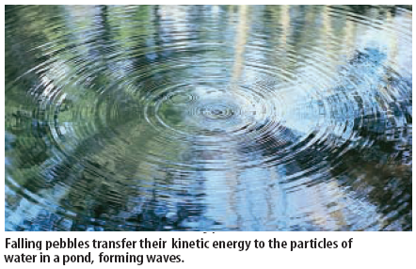
Waves transfer energy not matter. The water waves below are carrying energy but are not moving. Waves can only exist as they have energy to carry.
http://www.youtube.com/watch?v=ACeUO4ufx2I

Slide 4
What are mechanical waves?
Mechanical waves are waves which require a medium. A medium is a form of matter through which the wave travels (such as water, air, glass, etc.) Waves such as light, x-rays, and other forms of radiation do not require a medium.
What are the two kinds of mechanical waves?
1) Transverse Waves
In a transverse wave the matter in the wave moves up and down at a right angle to the direction of the wave

Slide 5
What are mechanical waves?
Mechanical waves are waves which require a medium. A medium is a form of matter through which the wave travels (such as water, air, glass, etc.) Waves such as light, x-rays, and other forms of radiation do not require a medium.
What are the two kinds of mechanical waves?
2) Longitudinal Waves (Compression Waves)
In a longitudinal wave the matter in the wave moves back and forth parallel to the direction of the wave

Slide 6
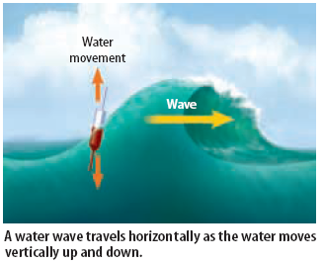
Example of a transverse wave:
phET Waves on a String

Slide 7
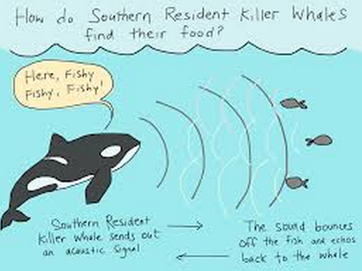
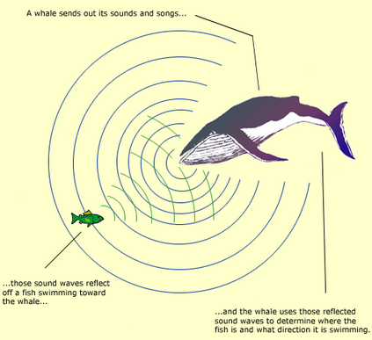
Sound Waves are compressional waves
Sound travels as vibrations moving through the air as a compressional wave.
Sound travels through air, but travels through other materials as well.
Whales communicate through long distances by producing sounds under water.
http://www.youtube.com/watch?v=BYiCzWZ8cBs
http://upuid-www-bbc-co-uk.tru-m.net/programmes/p00jz21r

Slide 8
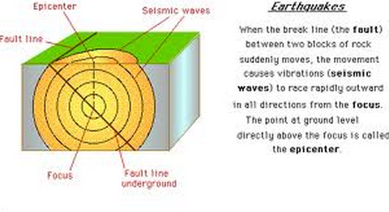
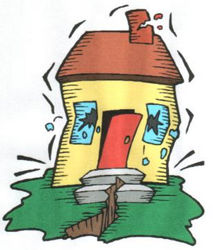
What are Seismic Waves?
An energy wave which vibrates through the earth’s crust as the crust bends or breaks.
Seismic waves exist as both transverse and compressional waves.
Some travel through the earth and some travel across the earth’s surface.

Slide 9
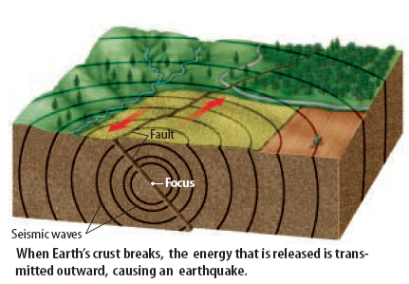
Anatomy of a Seismic Wave

Slide 10
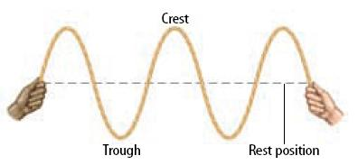
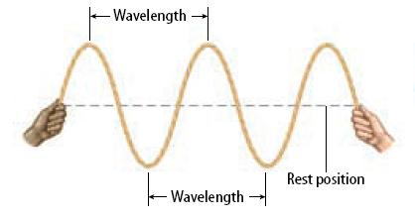
What are the parts of a wave?
Transverse wave
The crest is the highest point on a transverse wave. The trough is the lowest point on a transverse wave.
The rest position of the wave is called the node or nodal line.
The wavelength is the distance from one point on the wave to the next corresponding adjacent point.

Slide 11
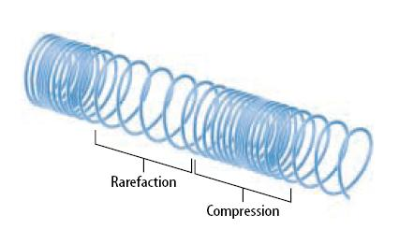
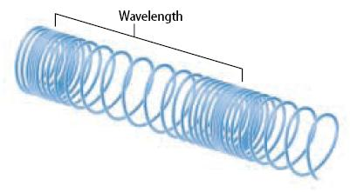
Compressional
Longitudinal wave
On a compressional wave the area squeezed together is called the compression.
The areas spread out are called the rarefaction.
The wavelength is the distance from the center of one compression to the center of the next compression.

Slide 12
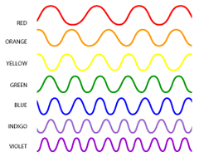
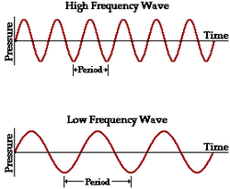
What is wavelength?
Wavelength is a measure of distance, so the units for wavelength are always distance units, such as meter, centimeters, millimeters, etc.
What is wave frequency?
Frequency is the number of waves that pass through a point in one second. The unit for frequency is waves per second or Hertz (Hz). One Hz = One wave per second.
Wavelength and frequency are inversely related.
The smaller the wavelength, the more times it will pass through a point in one second. The larger the wavelength, the fewer times it will pass through a point in one second.

Slide 13
Wavelength Comparison
Need to know a basic frame of reference- how do radio waves compare to gamma rays in terms of their wavelength & frequency, etc.

Slide 14
Frequency is the number of waves (vibrations) that pass through a point in one second.
Period is the time it takes for one full wavelength to pass a certain point.
Frequency is waves per second (f)
Period is seconds per wave (T)

Slide 15
What is Wave Speed?
A wave moving through a medium travels at a certain speed.
Wave speed is usually measured in meters/second, but may be measured using other distance units (such as centimeters per second).
How is Wave Speed calculated?
Wave speed is calculated as the product of a waves frequency and wavelength.
Wavelength is represented by the Greek letter lambda (λ) and frequency is represented by (f)

Slide 16
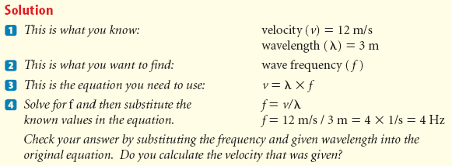

Slide 17
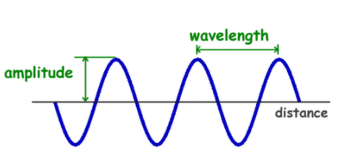
What is the amplitude of a wave?
The amplitude of a wave is directly related to the energy of a wave.

Slide 18
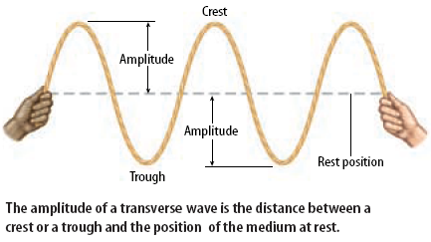
The amplitude of a transverse wave is determined by the height of the crest or depth of the trough

Slide 19
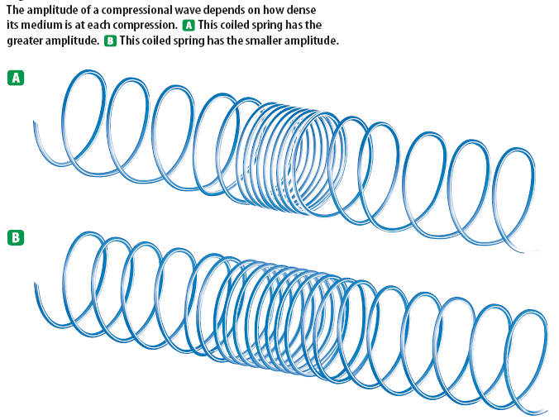
The amplitude of a compressional wave is determined by the closeness of the compressional waves. The closer the compressional waves and the farther the rarefaction lines.

Slide 20
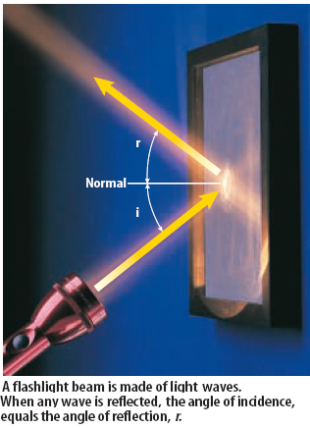
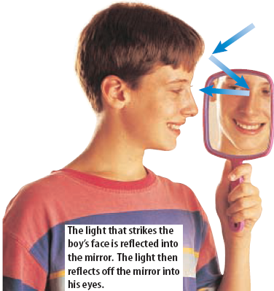
The Behavior of Waves
What is reflection?
When a wave bounces off an object and changes direction – this is reflection.

Slide 21
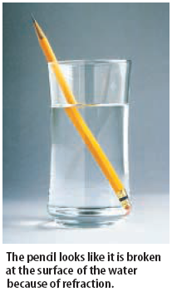
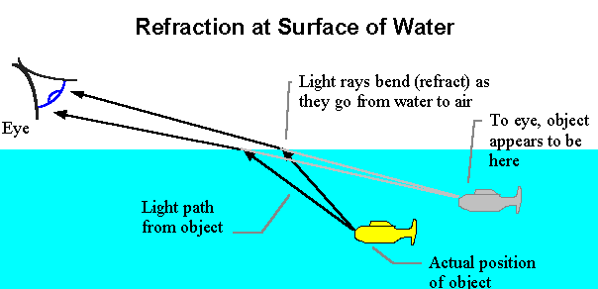
What is refraction?
Refraction is the bending of a wave as it passes from one medium to another.
A wave travels at different speeds in different things. When a wave traveling a certain speed moves into another medium, it will either increase in speed or decrease in speed, resulting in a change in direction.

Slide 22
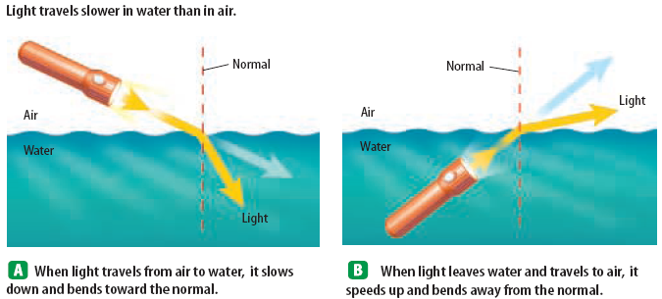

Slide 23
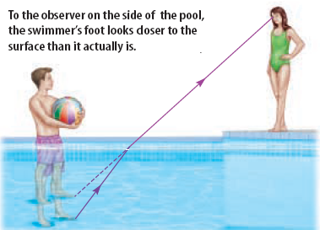

Slide 24
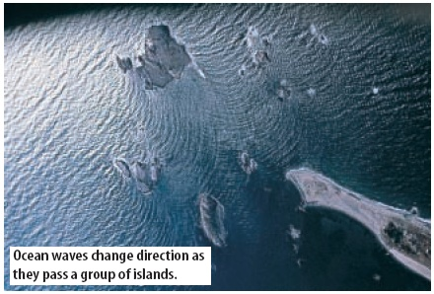
What is diffraction?
Diffraction occurs when an object causes a wave to change direction and bend around it.

Slide 25
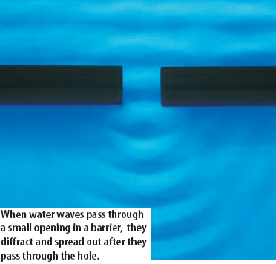
Diffraction also occurs when passing through a small opening. The waves diffract and spread out as they pass through the hole.

Slide 26
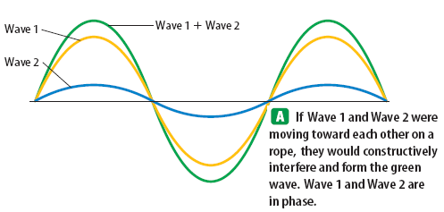
What is wave interference?
Occurs when two or more waves collide and occupy the same region of space and continue on.
Waves interfere in one of two ways: Constructive Interference and Destructive Interference.

Slide 27
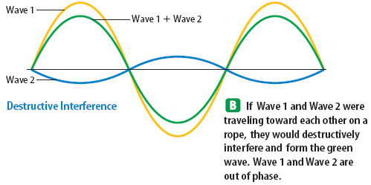
What is wave interference?
Occurs when two or more waves collide and occupy the same region of space and continue on.
Waves interfere in one of two ways: Constructive Interference and Destructive Interference.

Slide 28
What is Resonance?
Many objects have a natural frequency – vibrates in a regular pattern.
Resonance occurs when whenever a sound wave has the same frequency as the natural frequency of an object.
The sound will cause the object with the same natural frequency to vibrate.
http://www.physicsclassroom.com/class/sound/u11l4a.cfm
Pushing a person on a swing is a common example of resonance. The loaded swing (a pendulum) has a natural frequency of oscillation, its resonant frequency, and resists being pushed at a faster or slower rate.

Slide 29
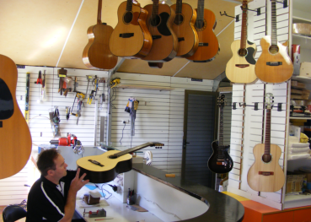
Resonance of instruments
Many musical instruments have resonance. The wood of a guitar or violin resonates with the same frequency as the string.
It is the goal of musicians to find instruments that possess the ability to vibrate with sets of frequencies that create desired sounds

Slide 30
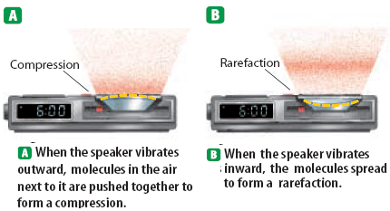
What is sound?
Sound is a compressional wave which travels through the air through a series of compressions and rarefactions.

Slide 31
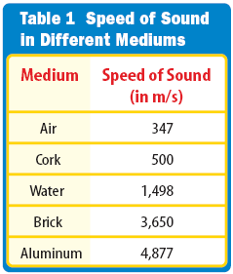
What is sound?
Sound travels through different media.
We hear sound which usually travels through air. Sound travels through other media as well, such as water and various solids.
Sound travels different speeds in different media. Sound typically travels faster in a solid that a liquid and faster in a liquid than a gas.
The denser the medium, the faster sound will travel.
The higher the temperature, the faster the particles of the medium will move and the faster the particles will carry the sound.

Slide 32
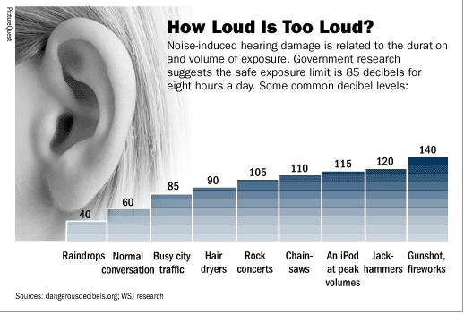
What is sound intensity?
Sound intensity is the energy that the sound wave possesses. The greater the intensity of sound the farther the sound will travel and the louder the sound will appear.
Loudness is very closely related to intensity. Loudness is the human perception of the sound intensity. The unit for loudness is decibels.

Slide 33
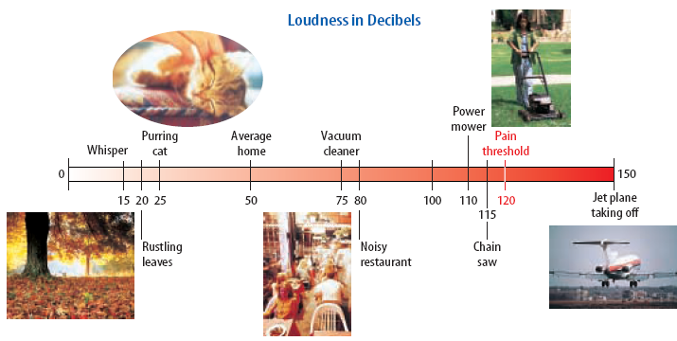
Loudness in Decibels

Slide 34
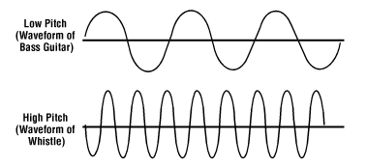
How is frequency related to pitch?
The pitch of a sound wave is directly related to frequency. A high-pitched sound has a high frequency (a screaming girl). A low-pitched sound has a low frequency (a fog-horn).
A healthy human ear can hear frequencies in the range of 20 Hz to 20,000 Hz. Humans cannot hear below 20 Hz. Sounds below this frequency are termed infrasonic.
Sounds above 20,000 Hz are termed ultrasonic. Some animals, such as dogs, can hear frequencies in this range in which humans cannot hear.
http://phet.colorado.edu/en/simulation/sound

Slide 35
Wavelength and frequency are inversely proportional.
http://www.youtube.com/watch?v=TKF6nFzpHBU

Slide 36
What is the Doppler Effect?
The Doppler Effect is the apparent change in frequency detected when the sound is moving relative to the hearer.
Video-Excellent example of Doppler Effect with car horn (26 seconds)
Video-A Motorcycle does the Doppler Effect (27 seconds)
Big Bang Theory Doppler Effect

Slide 37
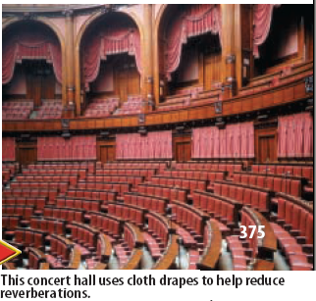
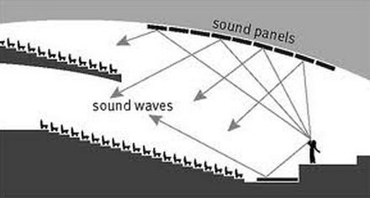
Using Sound
What is Acoustics?
Acoustics is the study of sound and ways to optimize the hearing of sound inside various structures.

Slide 38
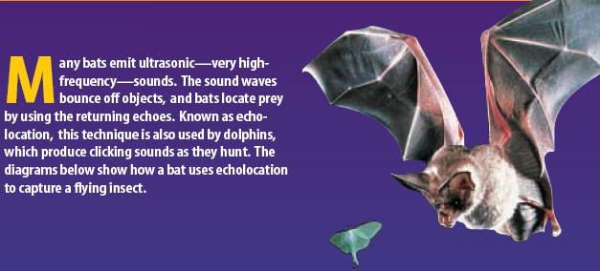
What is echolocation?

Slide 39
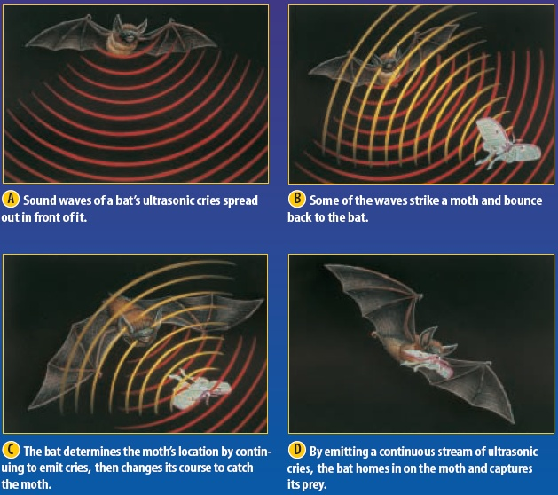

Slide 40
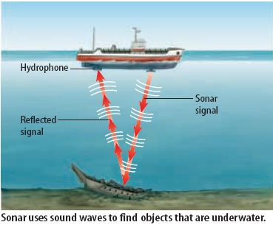
What is sonar?
Sonar is a system that uses the reflection of underwater sound waves to detect objects. This has been used to find sunken ships and schools of fish.

